Slide 1
Presentation Suggestions dsadsadsada
f
Dr. Burnett and Dr. Singiser
BIOL/CHEM 4900
testestestes
Photo courtesy of Dr. Nickie Cauthen
Notes:
Test Note. This should also be changed

Slide 2
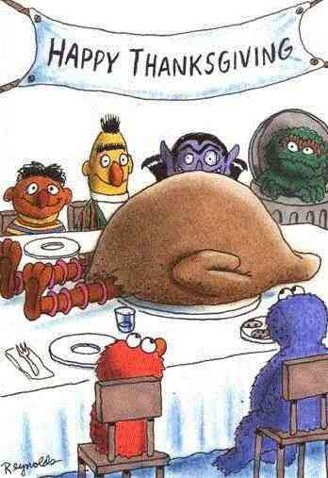
A Sad Day on Sesame Street
Citing your images
Use small print
http://www.bilibala.com/veryveryfunny/html/jokedata/sadday.html

Slide 3
Example of a Bad Color Scheme
Fonts in the same color family as the background do not show up well.
Here are some tips for good color combinations
Use the Design Templates
Go under the format menu and select Slide Design
Use the Standard Color schemes
You can’t go wrong with the dark blue background and yellow or white text

Slide 4
Another Bad Color Scheme
Dark text on dark background
Beware of shaded backgrounds
The dark text is harder to read down here

Slide 5
Distracting Backgrounds
Color
Too bright
Not enough contrast
Some colors will look different when projected
Distracting designs

Slide 6
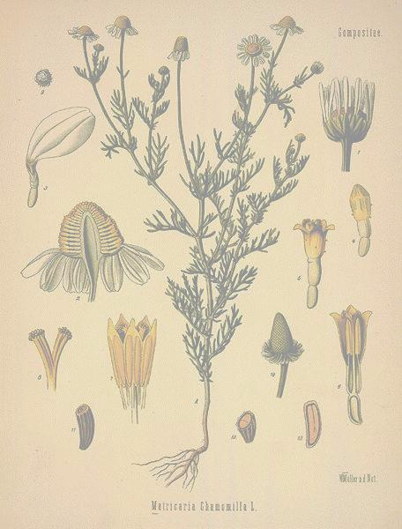
Regulation of Herbs and Drugs
Regulation varies from country to country
Herbs are classified as dietary supplements in United States
Manufacturers are limited in claims they can make
US Regulating Agencies
American Herbal Products Association
Natural Nutritional Foods Association
Safety with herbs
Be informed
Dosage
Side effects

Slide 7
Text on Slides
2131
d213
dasdsa
1122
dsadsa
3
123
How much text should be on a slide?
Presentation vs. lecture
Bullet points

Slide 8
Decorating Your House for Halloween
It is important to decorate your house for Halloween so that children can find who is giving out candy. If your house isn’t decorated then kids won’t come to your house.
Spooky decorations are fun, but they may scare the smaller kids away.
Cheesy decorations can be found EVERYWHERE and most people love them.
Funny decorations can be offensive to some so be careful. Make sure they are politically correct and clean.
Homemade decorations are the cheapest and they are fun to make. You can make spooky, cheesy and funny decorations for ½ the cost of buying them.

Slide 9
Halloween Decorations
Importance
Spirit
Marking your house
Types of Decorations
Spooky
Frightening
Hard to find
Cheesy
Cheap
Easy to find
Loved by all
Funny
Can be offensive
Homemade
Cheap
Fun to make
Variety
Photo courtesy of Dr. Nickie Cauthen

Slide 10
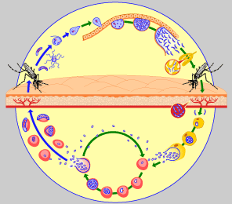
Plasmodium Life Cycle
http://www.who.int/tdr/diseases/malaria/lifecycle.htm

